Slide 1
Online (Portal) Course Registration
ÉCOLE SECONDAIRE KELVIN SCHOOL

Slide 2
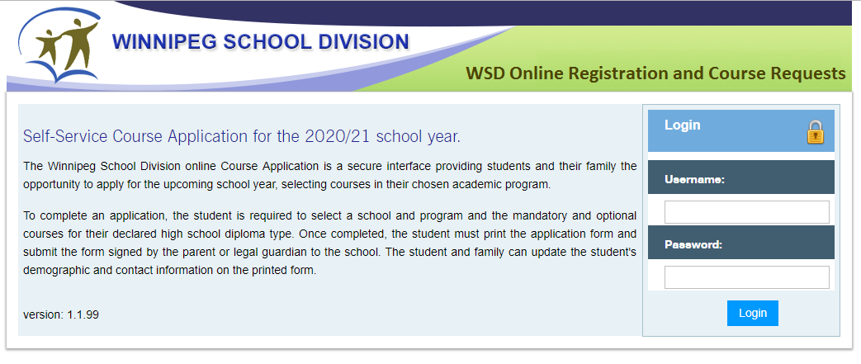
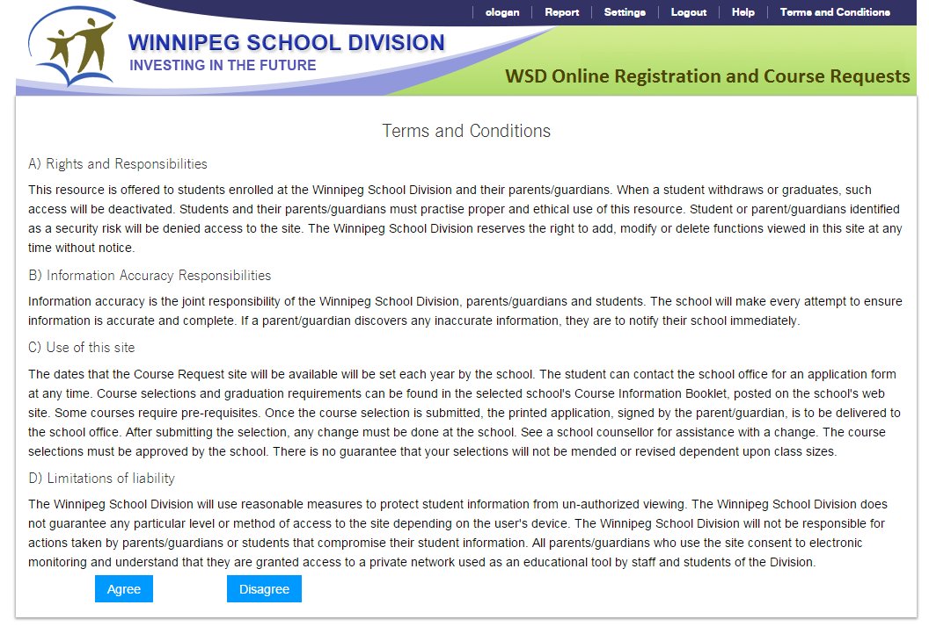
Please use Chrome, Firefox or Safari. Students login using their Novell Username (without @live.wsd1.org) and Password. Read the Terms and Conditions, Agree to continue.

Slide 3
Pre-Registration Tab
Select the year
Select the school
Click the “Add Preregistration” button

Slide 4
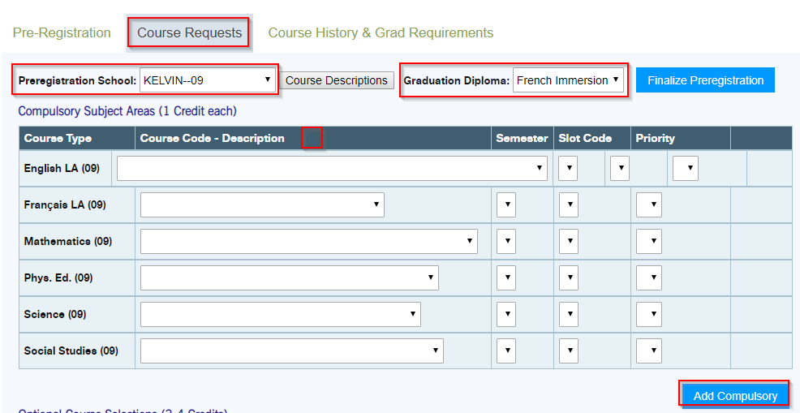
Course Requests Tab – Compulsory Subject Area 1) Select the Preregistration School 2) Graduation Diploma will determine the compulsory courses to select 3) Select All Compulsory Subjects (This is determined by grade and provincial prerequisites) 4) Click “Add Compulsory” button after all courses have been selected.

Slide 5
Course Requests Tab – Optional Course Selections 1) Option courses are listed by grade then alphabetically by course name. 2) If you wish to take an elective/optional course in a different grade, you must select the grade first. 3) Select the course 4) Click the “Add” button after EACH course 5) The courses will appear under the selection tool in a new line.

Slide 6
Once all course selections have been completed students must click on the “Finalize Preregistration” button. A warning popup window will appear. If you are confident you are finished, click “OK”. No changes can be made online after you finalize. Any changes after you finalize must be done in the Guidance Office.

Slide 7
Final Step - Run and print the Registration and Course Request Form The report link is at the top of the web page. This is a 6 page report that will open in a new tab. The first page is similar to the Student Description Form (application form) that Parents/Guardians can make any address/contact changes. The second page lists all the courses that you have selected. Part II of the registration form will include all of the divisional permission forms. These pages must be signed by a Parent/Guardian and returned to the school.

