Slide 1
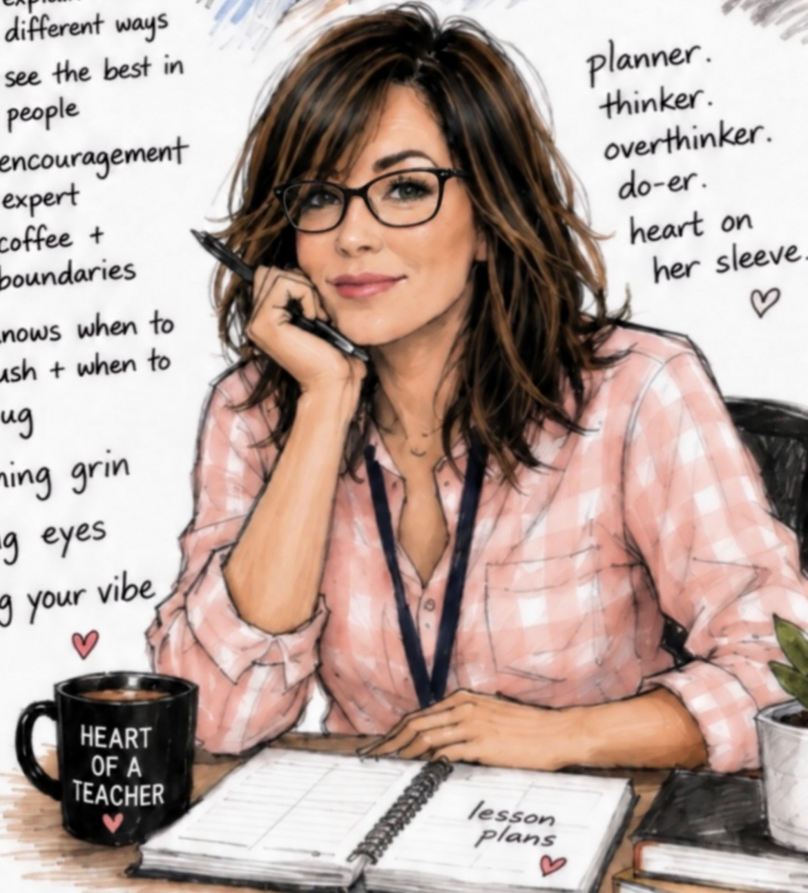
Welcome to Room 212!
MEET MS. TRUTHWAITE!
GREETINGS!
z
My name is Jeanne Truthwaite, and I will be your child's teacher for grade 7 & 8 English Language Arts and Social Studies. I am looking forward to getting to know and teach every one of them!
CONTACT INFORMATION
jtruthwaite@wsd1.org
(204) 589-4313
SUBJECT OUTLINE
ELA
Social Studies
- Daily Edits
- Spelling
- Vocabulary
- Paragraph/Essay Writing
- Poetry/Figurative Language
- Short Stories
- Novel Study
-
Residential School History
Canada & World Geography Mapping
Global Quality of Human Life/ Human Rights
Ways of Life in Asia, Africa, or Australia (Class Choice)
-
-
-
Be kind and respectful to one another. 😊

